Slide 1


AI Application System
(ISE4132)
Week _ Lecture
ISE Department Prof. Mehdi Pirahandeh
School of Global Convergence Studies

Slide 2

Combining Policy Gradient and Q-Learning (Part II)
1
School of Global Convergence Studies

Slide 3
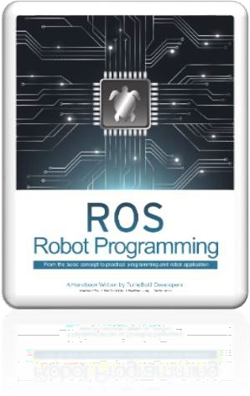
Contents
Soft Actor Critic (SAC)
School of Global Convergence Studies

Slide 4
Soft Actor Critic (SAC)

Slide 5
Soft Actor Critic (SAC)
SAC and TD3 and DDPG
All uses an actor-critic construct with off-policy learning for continuous controls
Unlike TD3 and DDPG, SAC learns a stochastic policy.
SAC uses the clipped double-Q trick like TD3
A core feature of SAC is use of entropy as part of maximization.
SAC vs TD3
Similarities
Both uses mean squared Bellman error (MSBE) minimization toward a common target
A common target is calculated using target Q networks that are obtained using polyak averaging
Both use clipped double Q, which consists of a minimum of two q-values to avoid overestimation
Differences
SAC uses entropy regularization, which is absent in TD3
The TD3 target policy is used to calculate the next-state actions, while in SAC we use the current policy to get actions for the next states
In TD3, the target policy uses smoothing by adding random noise to actions. However, in SAC the policy learned is a stochastic one that provides a smoothing effect without any explicit noise addition
School of Global Convergence Studies
Notes:
While DQN solves high dimensional state space, it can only handle discrete and low-dimensional action space. DQN cannot be applied to continuous and high-dimensional action domains. (e.g. control tasks like robots)
DDPG is an algorithm that is as follows:
Model Free: we don’t know the model. We learn it from interaction of the agent with the environment
Off-Policy: DDPG, like DQN, used as exploratory policy to generate transitions and learns a deterministic policy
Continuous and high-dimensional action space: DDPG works only for a continuous action domain and works well with high-dimensional action spaces
Actor-Critic: this means we have an actor (policy network) and critic, the action-critic-value (q-value) network
Replay-Buffer: like DQN, DDPG uses a replay buffer to store translations and uses them to learn. This breaks the temporal dependence/correlation of training examples, which could otherwise mess up the learning
Target Network: like DQN, it uses a target network to provide fairly stable targets for the q-values to learn. However, unlike DQN, it does not update the target network by copying over the weights of online/agent/main network periodically. Rather, it uses the polyak/exponentional average to keep moving the target network a little bit after every update to the main network

Slide 6
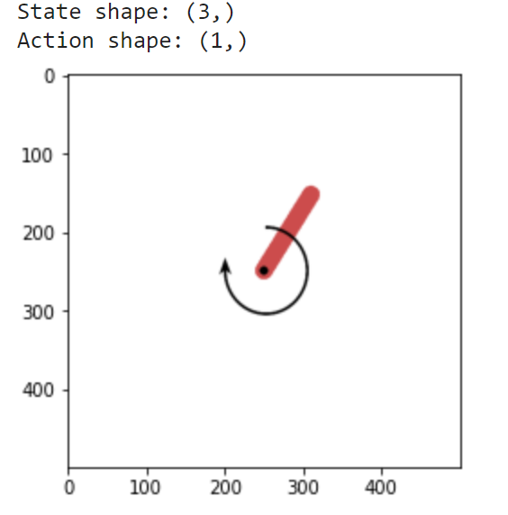
Soft Actor Critic (SAC)
Environment – |Pendulum-v1|
School of Global Convergence Studies

Slide 7
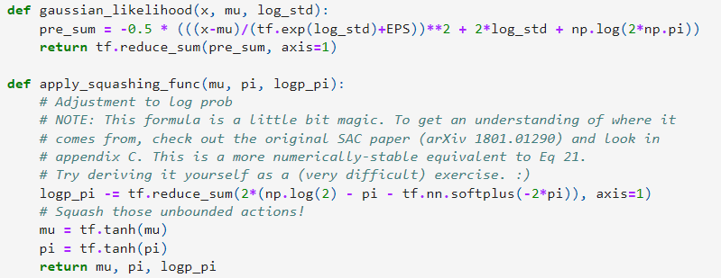
Soft Actor Critic (SAC)
‘gaussian_likelihood’ implementation
School of Global Convergence Studies
Notes:
The core Tensorflow package does not have functions to calculate the log likelihood that we need for entropy. We implement our own small function ‘gaussion_likelihood’ to do it.

Slide 8
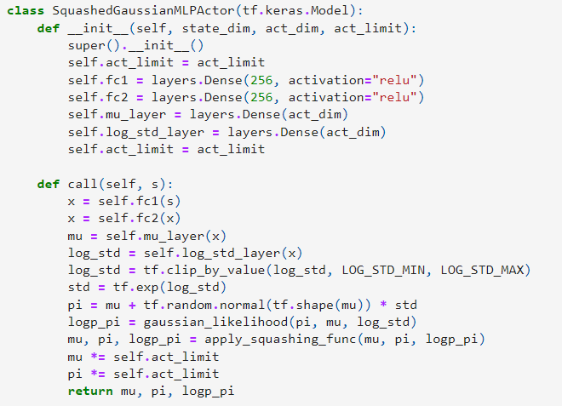
Soft Actor Critic (SAC)
Policy Network Actor Implementation
School of Global Convergence Studies

Slide 9
Soft Actor Critic (SAC)
Q-Network Critic
Combined Model
ReplayBuffer
Q-Loss
Policy-Loss
One-Step Update
SAC Main Loop
*Refer to the implementations for TD3
School of Global Convergence Studies
Notes:
The Q-function network ‘MLPQFunction’,
which combines the actor and critic together into an agent in class ‘MLPActorCritic’,
and ‘ReplayBuffer’,
Q-loss and Policy-loss impementations are similar as we saw for TD3

Slide 10
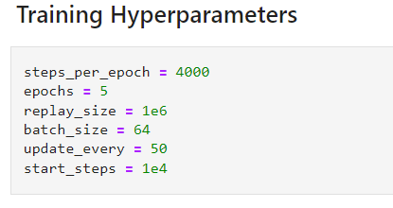
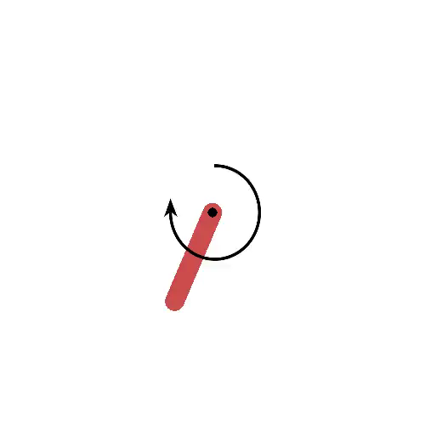

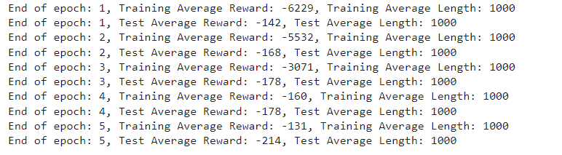
Soft Actor Critic (SAC)
School of Global Convergence Studies
Notes:
Once we run and train the agent, we see similar outcomes as DDPG and TD3. as Discussed, we are using simple environments, hence all three continuous control algorithms (DDPG, TD3, and SAC) behave well.

